Slide 1
Session 2 – Abstraction and Testing Data Skills for Research Kellogg Research Support
August 14, 2023

Slide 2
Three Lessons
Declarative > Procedural
Modular > Monolithic
Automatic > Manual
Notes:
All these things turn procedural unspoken knowledge into explicit, declarative and executable specifications

Slide 3
Roadmap
Declarative Practices
Specify your environment
Use code, not your mouse
Use source control
Modules
Structure code into functions
Group functions into files
Automating Code Execution
Write automatic tests
Turn your code into executable scripts
Notes:
All these things turn procedural unspoken knowledge into explicit, declarative and executable specifications

Slide 4
1. Declarative Practices
Declarative > Procedural
Modular > Monolithic
Automatic > Manual
Notes:
All these things turn procedural unspoken knowledge into explicit, declarative and executable specifications

Slide 5
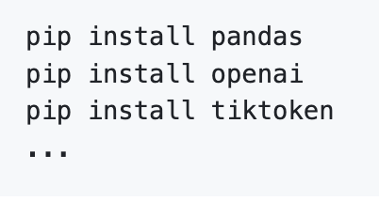

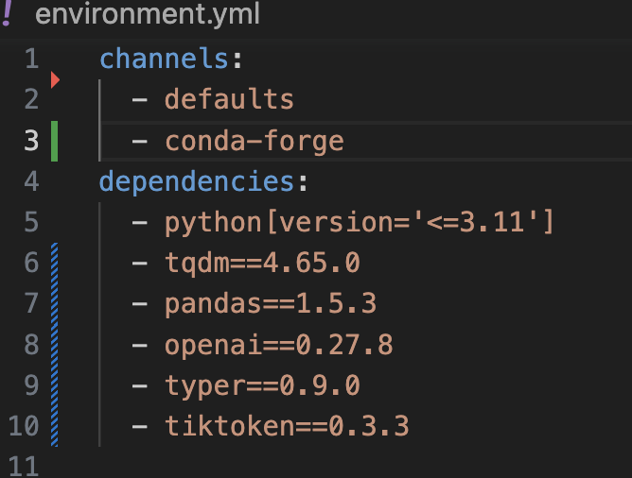
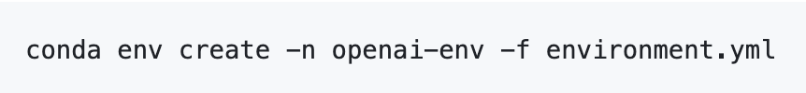
Specify Environments
Notes:
Demo conda on KLC

Slide 6
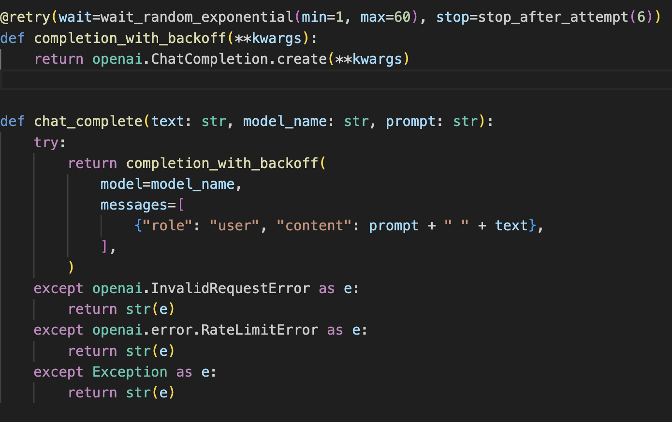
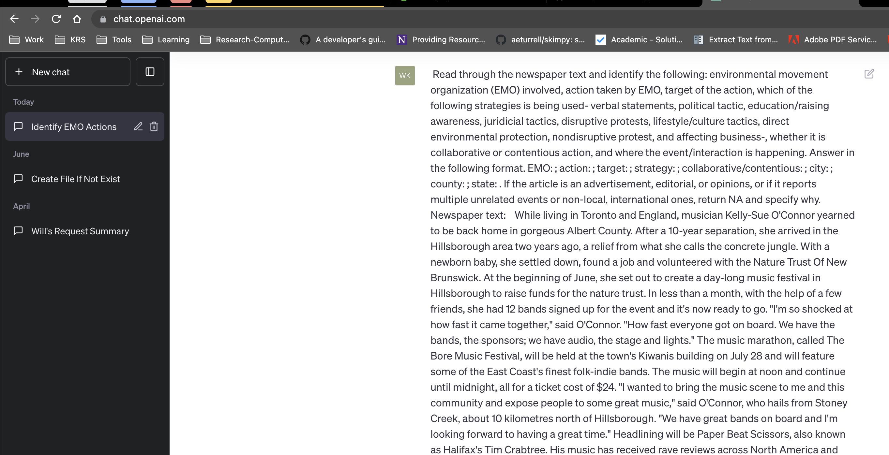
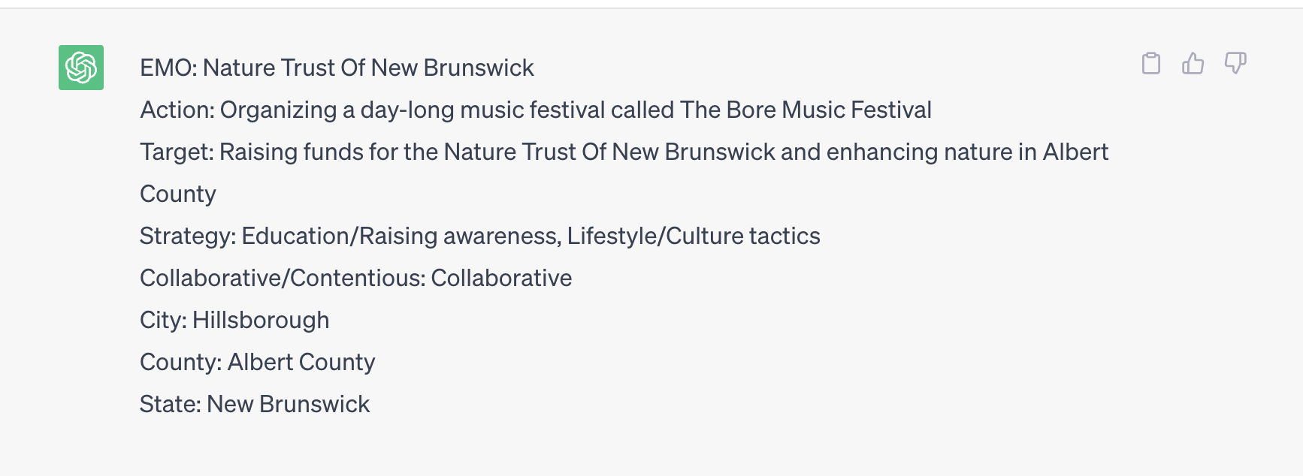
Code vs. Mouse

Slide 7
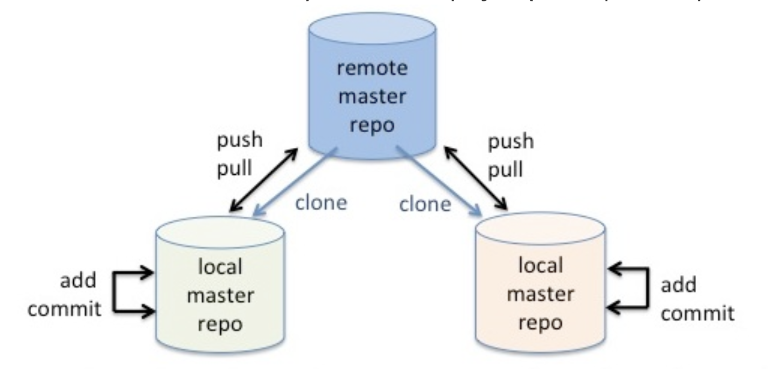
Source Control
Notes:
Demo github, clone onto laptop, KLC

Slide 8
2. Modularity
Declarative > Procedural
Modular > Monolithic
Automatic > Manual
Notes:
All these things turn procedural unspoken knowledge into explicit, declarative and executable specifications

Slide 9

Abstract Code into Modules
Modularity: breaking code down into manageable, configurable, cohesive, and maintainable chunks

Slide 10
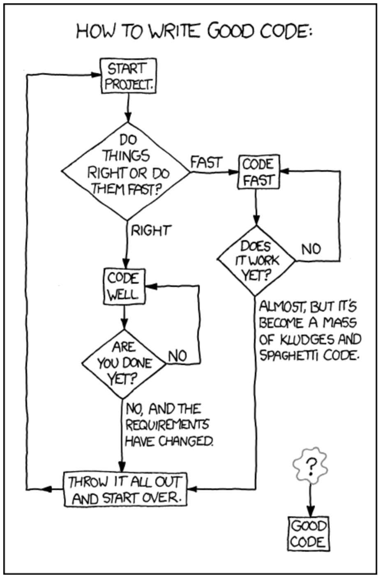


Benefits of Modules
Easier to understand
Easier to test for correctness
Easier to change and update
Combinatorial goodness

Slide 11
Functions as Modules
The basic way to organize code is into functions and groups of functions
Functions can be included in core language
Functions can be added through 3rd party libraries
Functions can be also be user defined
But don’t reinvent the wheel
Example: Python’s numpy vs. roll your own: numpy is orders of magnitude faster, and much less likely to have bugs
But beware of poorly documented or maintained 3rd party code

Slide 12
Guidance for Defining Functions
Functions should extract logic into a single source of truth
Each function should do only one thing – keep it simple
Organize functions into groups (files, packages)
Test function inputs with assertion statements
Test function with unit tests

Slide 13
Repetitive Code
// Load the "nlswork" dataset (if not already loaded)
use https://www.stata-press.com/data/r17/nlswork.dta
// Subset the dataset for the year 1976
keep if year == 76
// Run fixed effects regression for the year 1976
xtreg wage, fe
estout, title("Fixed Effects Reg by Year 1976") cells(b(star fmt(%9.3f)) se(fmt(%9.3f))) replace
// Subset the dataset for the year 1978
use https://www.stata-press.com/data/r17/nlswork.dta, clear
keep if year == 78
// Run fixed effects regression for the year 1978
xtreg wage, fe
estout, title("Fixed Effects Reg by Year 1978") cells(b(star fmt(%9.3f)) se(fmt(%9.3f))) replace

Slide 14
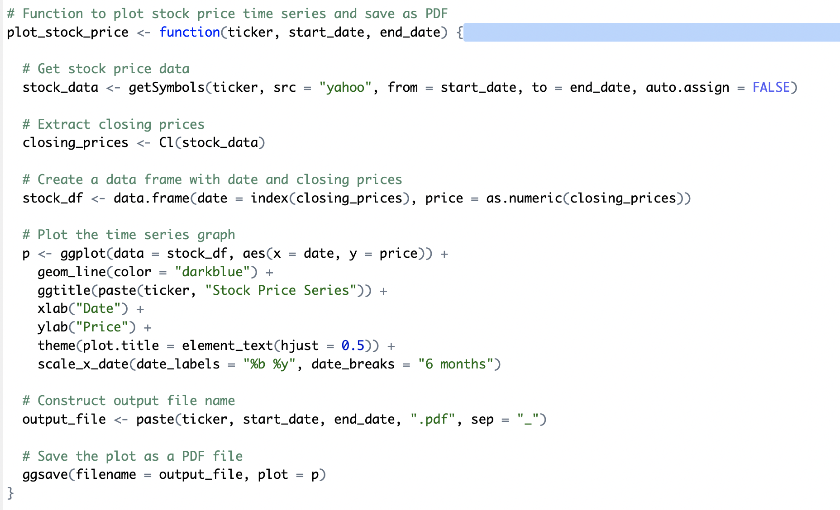
Do Everything Functions

Slide 15

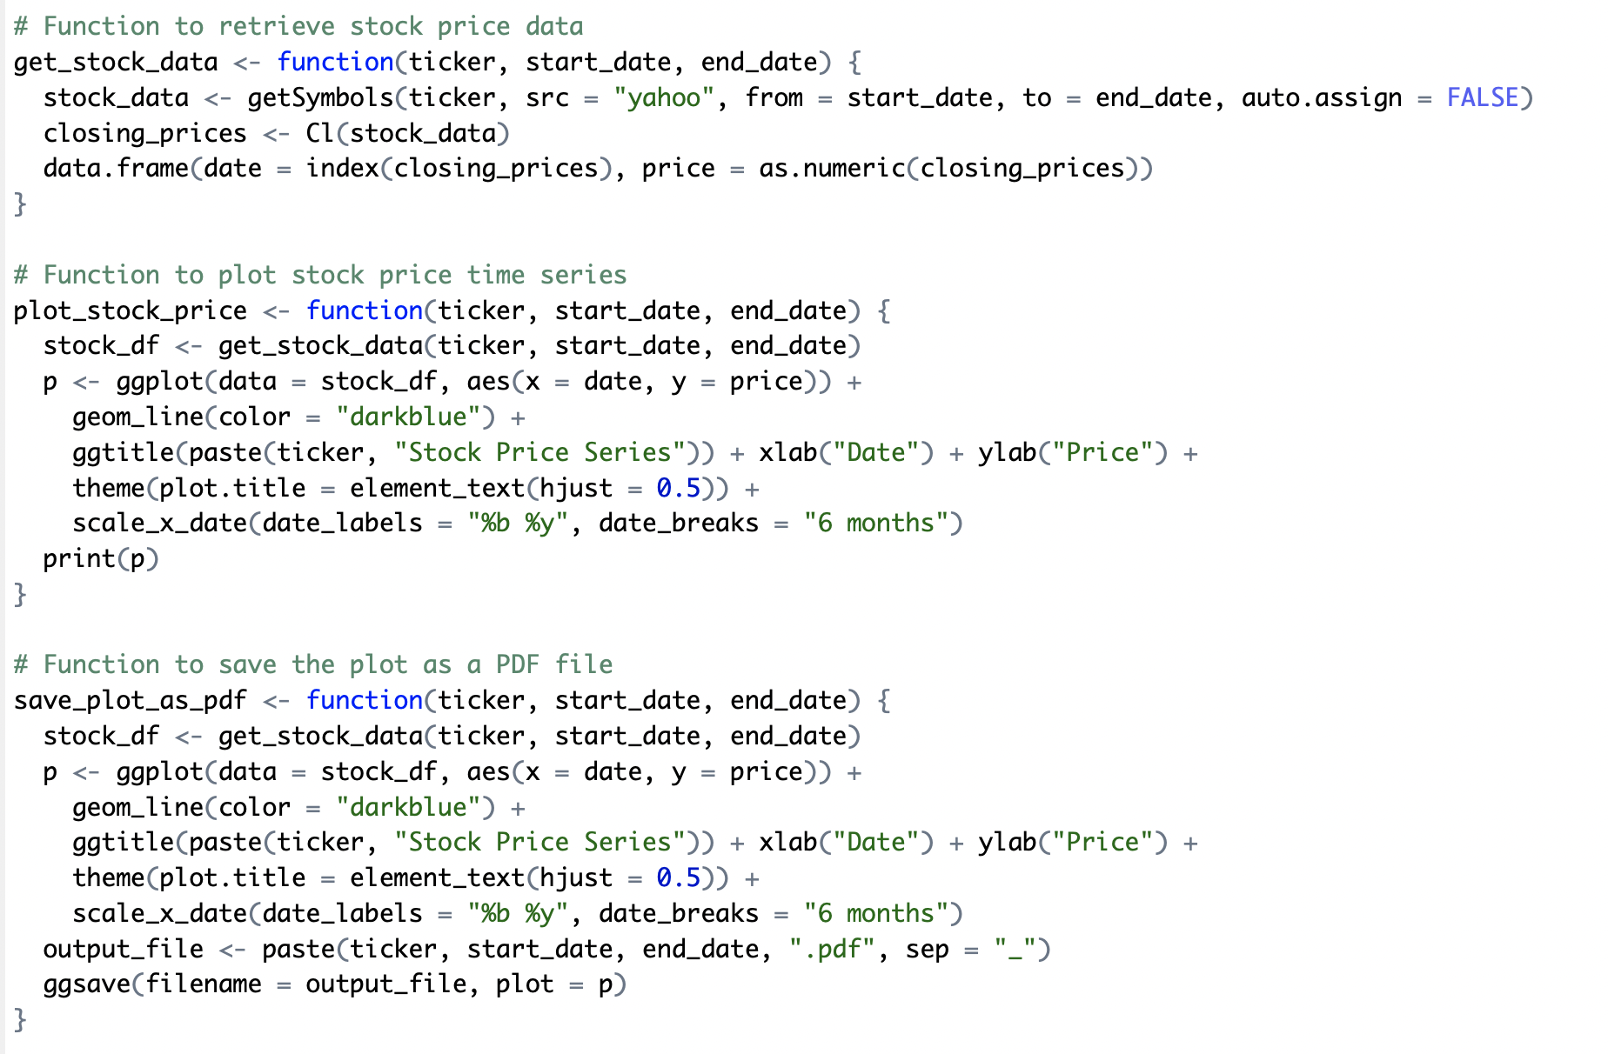
Modular Functions

Slide 16
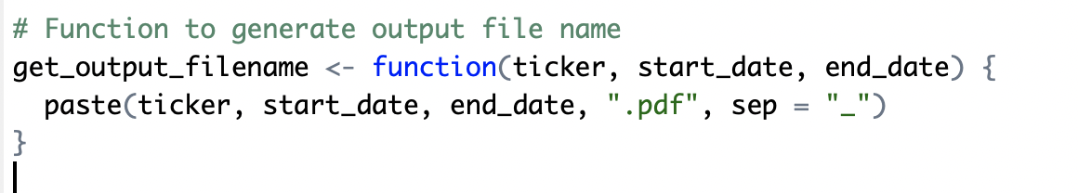
Functions should be useful!
Caveat: a function can be too simple to be worth the trouble:
Prompt: what could we add to make such a function worthwhile?

Slide 17
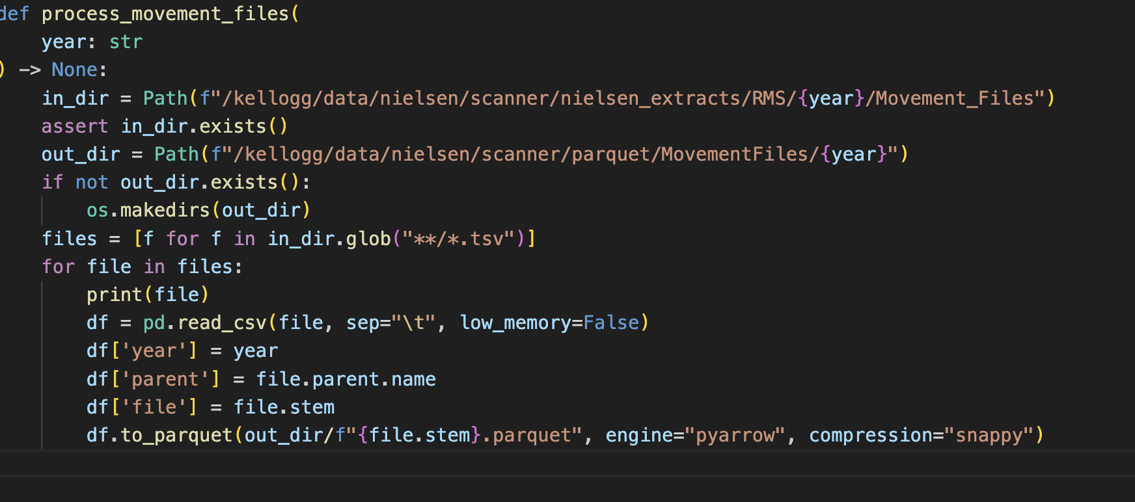
Validate Function Inputs

Slide 18
3. Automation
Declarative > Procedural
Modular > Monolithic
Automatic > Manual
Notes:
All these things turn procedural unspoken knowledge into explicit, declarative and executable specifications

Slide 19
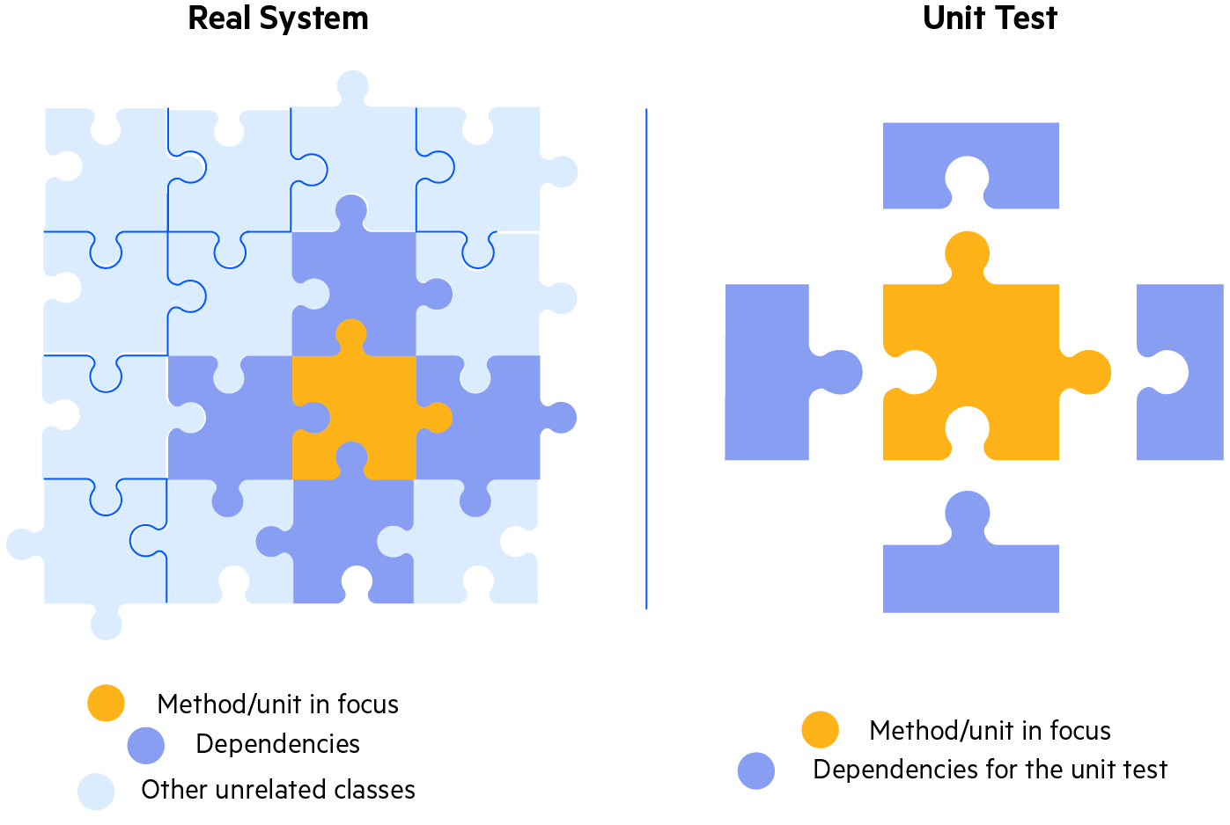
Automated Tests
Unit Tests :
The goal of unit testing is to test a single “unit” of the code in isolation.
For instance, execute a single function with a range of inputs and validate the corresponding outputs

Slide 20
Unit Tests
Proper unit testing is automatic, not manual
Each unit test has three parts:
setup input
activate code, and
assert result
Best to write code and tests at the same time!
Assertions around testing… does this file exist.

Slide 21
Testing a Function (unit test the R functions)
Good test: does directory/file exist already?
Inspecting content of file
Unit tests for the function that processes files in a given directory/year
Demonstrate utility of assertions/exceptions over silently failing
Making assumptions explicit:
Good -- Comment the assumptions for a functions
Better -- Use assert statements to test for your assumptions

Slide 22
Python Example

Slide 23
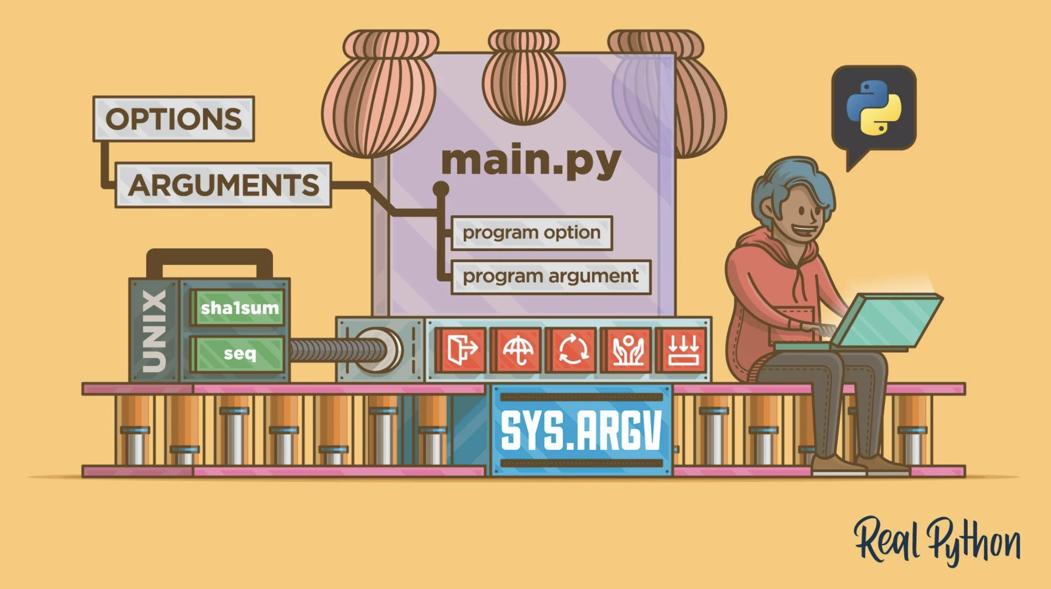
Command Line Interfaces

Slide 24
Command Line Arguments – Examples
Lead with R examples, move to Python/typer
Discussion – Any examples of when you use or would like to use command line arguments?
Run files on another year
Different input parameters, random seeds, bootstrap with 1,000 or 10,000 etc.
Change model specifications, or graphs and titles

Slide 25
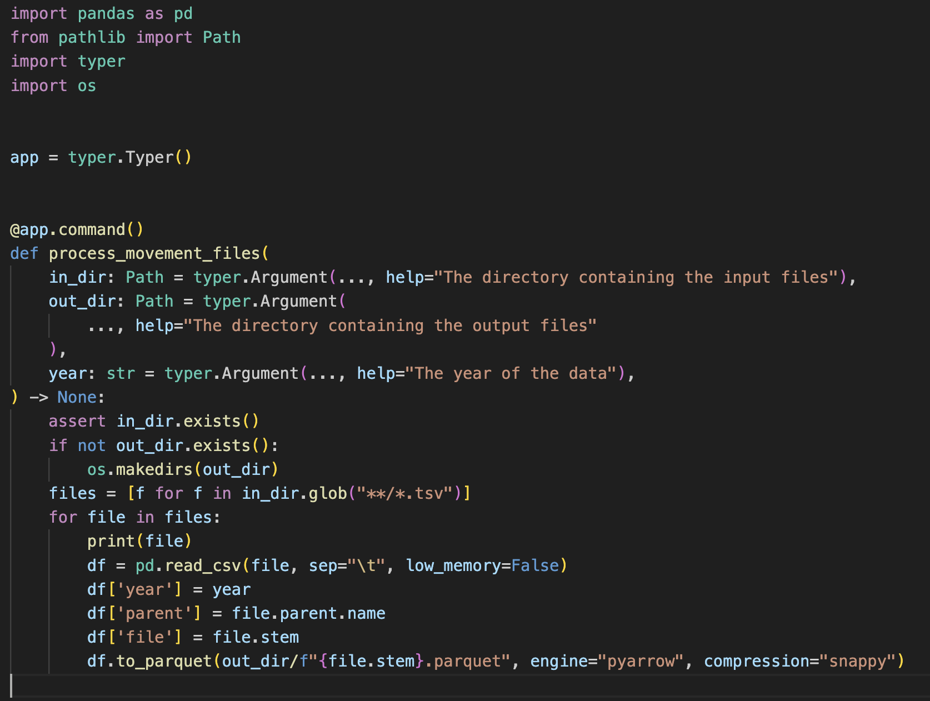
Example: Command Line Interface (CLI)

Slide 26
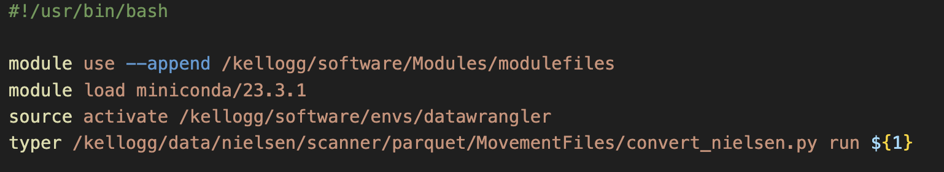

Turn into a Script

Slide 27
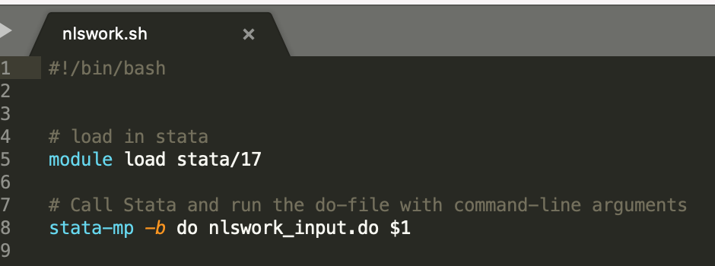
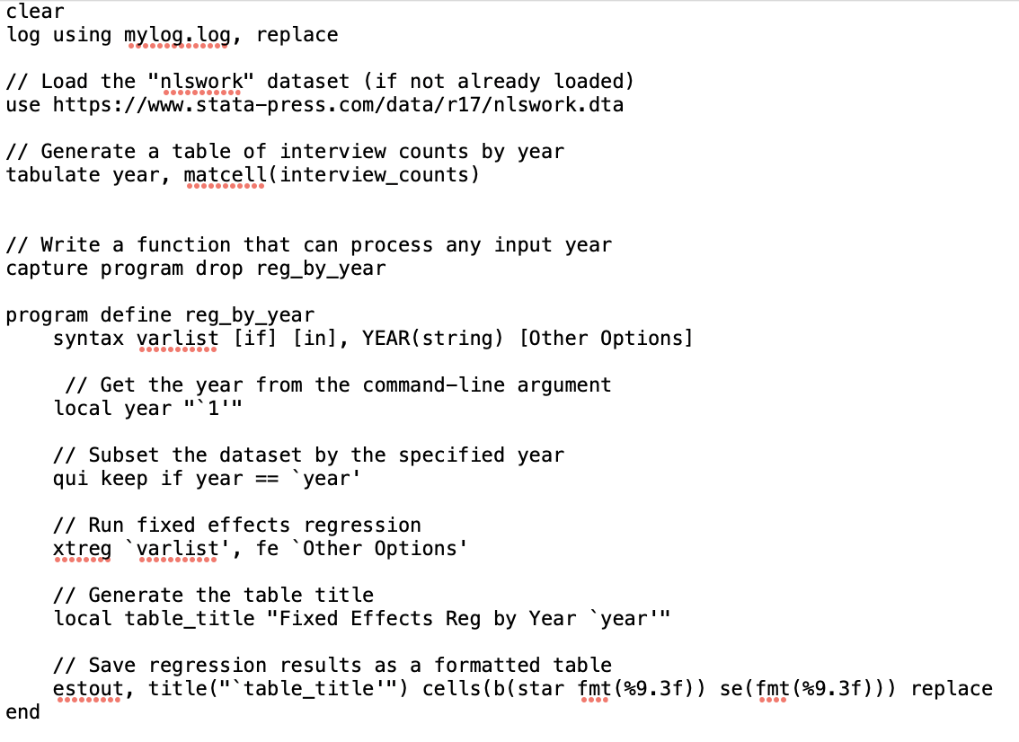
Example: CLI for Stata
nlswork_input.do

Slide 28
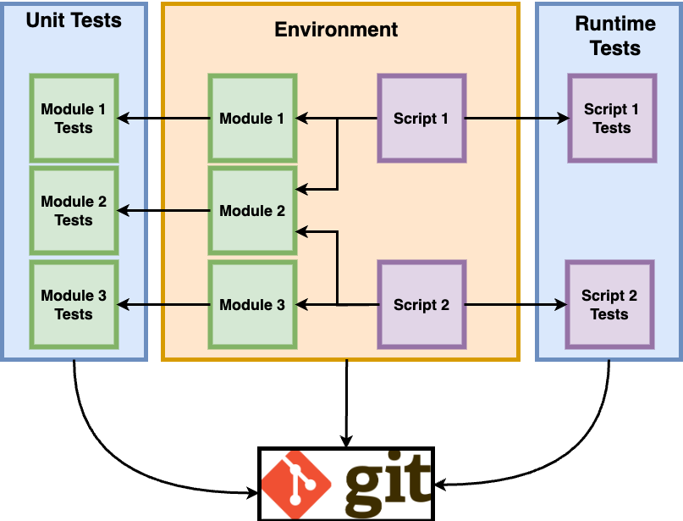
Conclusion: Big Picture
Version Control

